Slide 1
"Unit 3: "For Live Session"
Chad Madding

Slide 2
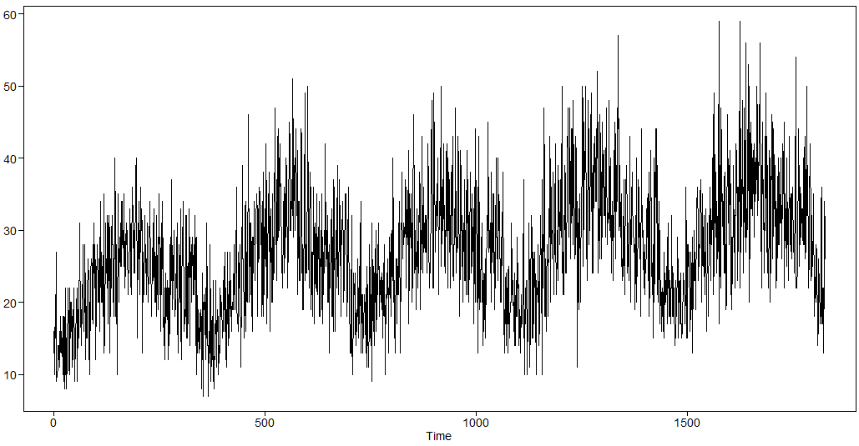
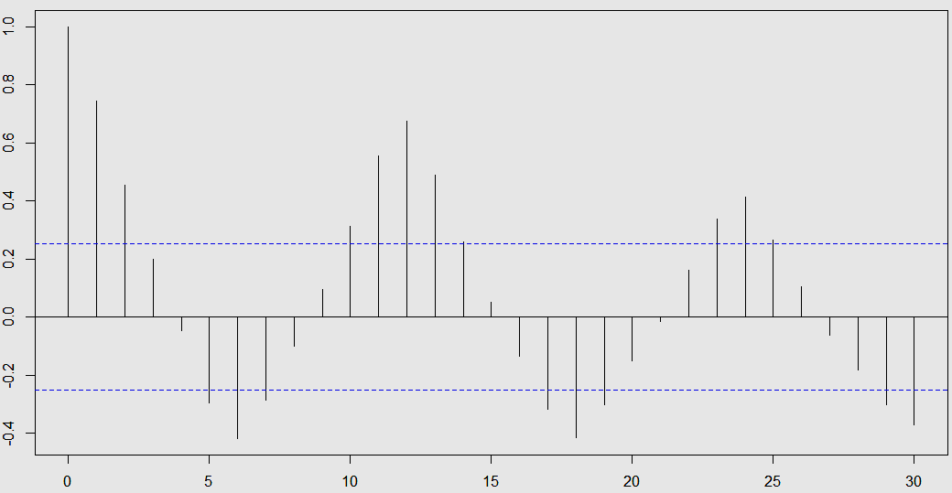
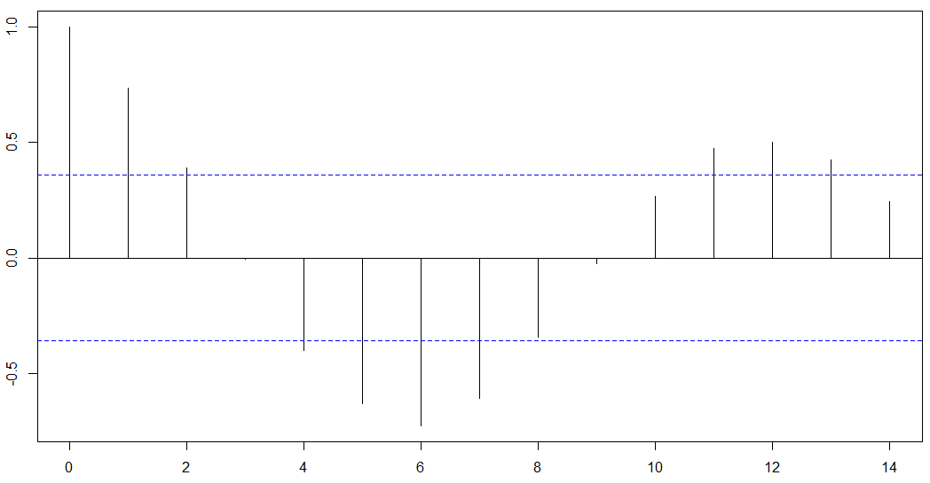
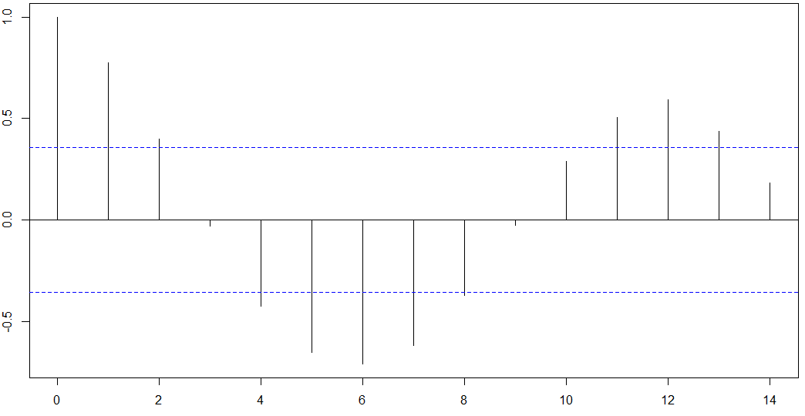
Walmart Data Stationarity
Condition 1:
This is 1826 daily observations (about 5 years) of data measuring sales of one item at one Wal Mart. It looks as if there is a seasonal component to the series. This is evidence against a stationary time series.
Condition 2:
Given that the series is not thought to be stationary, it is tough to assess the constant variance since we only have one observation per day.
Condition 3:
Evidence of the annual seasonal trend in the series is found in the ACF (of all the data, to the far right) with a spike in the autocorrelation at lag 12.
Judging from the ACFs of the first half (bottom left) and the second half (bottom right) of the series, we see evidence that the autocorrelations do not depend on where they are in time, rather just on the lag. We can see and conclude from the ACFs that the signal on the right is not stationary (since later lags exceed the confidence interval).
Conclusion
Because the three conditions of a stationary time series cannot be confirmed, it must be concluded that this is not a stationary time series and that there is a dependency on time driving the position of each successive data point.

Slide 3
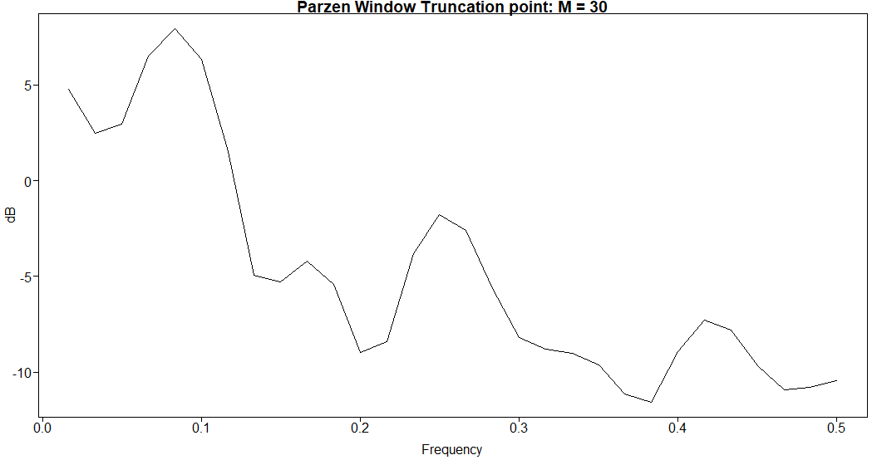
The client believes there is yearly and weekly seasonality in the data. Is there evidence of this with respect to the spectral density?
Spectral Density:
There is a peak in the spectral density at 0 which is evidence of some wandering behavior that is apparent in the realization.
There is also evidence of cyclic behavior in the realization which is supported both by our intuition and the spectral density. There is a peak at about .083 which is indicative of a period at 1/.083 = 12, showing evidence of some monthly seasonality. This makes sense intuitively as an annual cycle seems to make sense in this sales data.
There also looks to be evidence of a peak in the spectral density at .25 and .41. These would correspond to a period of 4 and 2.4. Since this data has been grouped by months this is evidence of some weekly seasonality.

Slide 4
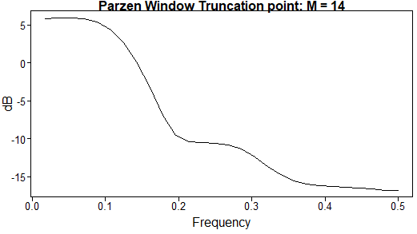
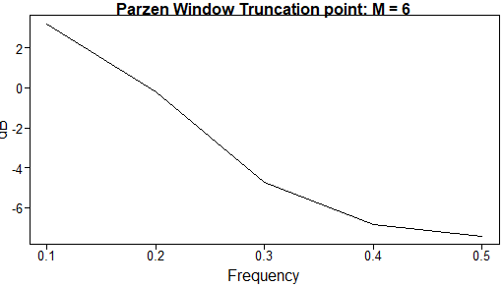
Take the Walmart data and do a five-point moving average and 51-point moving average. Show the spectral density for each and comment on the results.
5-Point Moving Average
51-Point moving average
Spectral Density of a 5-Point Moving Average:
There is still a peak in the spectral density at 0 which is evidence of some wandering behavior that is apparent in the realization.
There is also evidence of cyclic behavior in the realization which is supported both by our intuition and the spectral density. The peek around .083 which is indicative of a period at 1/.083 = 12, showing evidence of some monthly seasonality, is starting to fade.
The other two peak in the spectral density at .25 and .41 are also smoothing out.
Spectral Density of a 51-Point Moving Average:
With so much information being taken away with such a large smoothing number about the only information we can see here is there still seems to be some evidence of some wandering behavior with a peak in the spectral density at 0. There are small breaks at .2, .3 and .4 which could be seen more predominately in the 5-Point Moving Average.
#Setup a 5 Point Moving Average Filter
ma5 = stats::filter(Stor8Item1_grouped$mean_sales,rep(1,5))/5
ma5 = na.remove(ma5)
#Plot the Low Pass 5 Point Moving Average
plot(ma5,type = 'l')
parzen.wge(ma5)
plotts.sample.wge(ma5)
#Setup a 51 Point Moving Average Filter
ma51 = stats::filter(Stor8Item1_grouped$mean_sales,rep(1,51))/51
ma51 = na.remove(ma51)
#Plot the Low Pass 51 Point Moving Average
plot(ma51,type = 'l')
parzen.wge(ma51)
plotts.sample.wge(ma51)

Slide 5



AR(1): X _{t} – φ ₁X_{t – 1} = a_{t}
Stationarity:
Stationary if |$φ_{1}$| <1
Autocorrelation:
$$ρ_{k}=\text{j}\text{1}\text{k} for k ≥1$$
damped exponential
(oscillating and exponentially damping if ϕ₁ <0)
Realizations look like:
ϕ₁ > 0 : Seem to be “wandering,” aperiodic in nature. (ϕ₁ Positive)
ϕ₁ < 0 : Seem to be “oscillating” (ϕ₁ Negative)
Spectrum:
has a peak at f = 0 (ϕ₁ > 0) or f = 0.5 (ϕ₁ < 0)

Slide 6
A brief reflection of thoughts and key takeaways – Week 3
The last slide did a great job of recapping what this week 3 was about:
AR(1) Models: Summary
Realizations are wandering or oscillating depending on whether the root of the characteristic equation is positive or negative, respectively.
Autocorrelations are damped exponentials or damped oscillating exponentials depending on whether the root of the characteristic equation is positive or negative, respectively.
Spectral densities have a peak at f = 0 or f =.5 depending on whether the root of the characteristic equation is positive or negative, respectively.
Question: How do you work out this from the videos? I got the Root correct but could not see how the inverse of the root worked.
What is the inverse of the root: |r|–1? Please express your response to the nearest tenth. The answer is 1.2 so I am guessing r would have to be the AV of 2.2. I got a Z equal to -0.833 so ho do you work that back in to get r?

